Slide 1


Ontologies in behavioural Science
Susan Michie
University College London, UK
@SusanMichie
SBM, San Antionio, USA, 2015

Slide 2
What is an Ontology?
a structure that systematically represents and organises the essential elements of behaviour change interventions
  Codifies our collective knowledge
  Reflects consensus on concepts, terms, relationships
  Specifies and formalises them
    Collaboration with computer science

Slide 3
Four reasons why we need an ontology of behaviour change
So that we can organise our knowledge efficiently
  To move away from the present unstructured, disorganised, chaotic heterogeneity and fragmentation that dominates our field
So that we use the same terms for the same concepts
  So that we understand each other, don’t speak at cross purposes

Slide 4
To maximise efficiency in accumulating evidence and developing theories
  By sharing an ontology and standardised terms, we can synthesise evidence efficiently and test theories coherently
To harness the possibilities of computational modelling of behaviour change
  Allowing an acceleration of analysing Big Data in real time to further our understanding of behaviour change

Slide 5
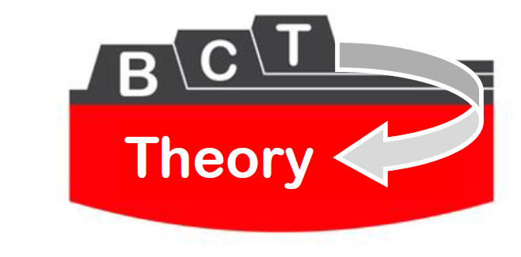
Building an Ontology: current work
We have published a method for defining the ‘content’ of interventions: a taxonomy of behaviour change techniques (BCTs)
  Michie et al (2013) Annals of Behavioral Medicine
We are in the process of the subsequent study to link these to their ‘mechanisms of action’ (theoretical constructs/domains)
  Michie, Johnston, Rothman, Kelly, de Bruin, 2014-17
Behaviour taxonomy
  Larsen, West & Michie

Slide 6
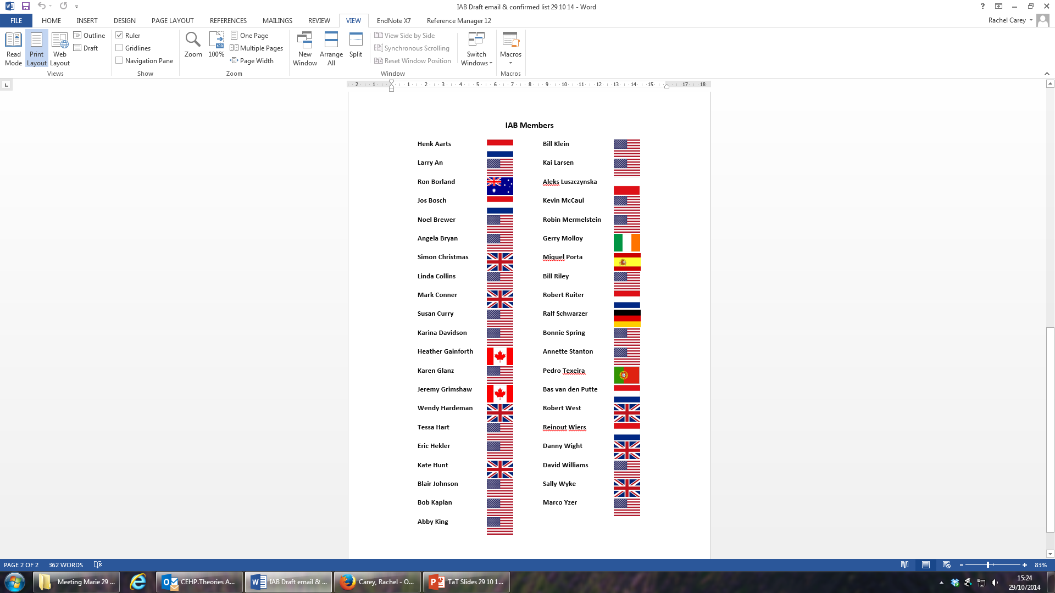
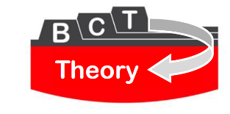
International
Advisory
Board
41 members from 10 countries
Website: ADD

Slide 7



BCT Taxonomy v1
Applies to an extensive range of behaviour change interventions
Agreed by an international consensus to be potential active components of interventions
  400 participants from 12 countries
Clearly labelled, well defined, distinct, precise; can be used with confidence by a range of disciplines and countries
93 items hierarchically organised to improve ease of use Cane et al, BJHP, 2014

Slide 8

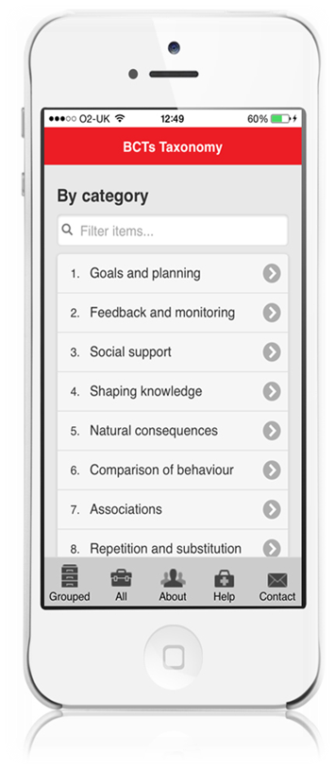




The BCTTv1 smartphone app
Fully searchable version of BCTTv1
Search by BCT label, BCT grouping or alphabetically
Increases familiarity with the taxonomy
Increases speed and recall of BCT labels and definitions
Search for: BCTs
bcts.23.co.uk*
Search for: BCTs*
bcts.23.co.uk*
* You’ll need an internet connection to use the app

Slide 9
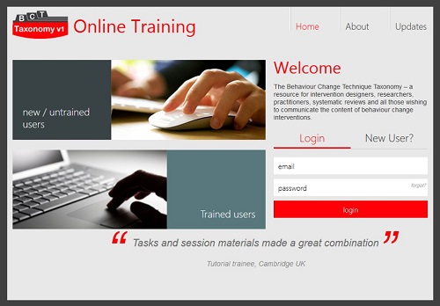
www.bct-taxonomy.com

Slide 10
An Ontology of Behaviour Change Interventions
Influences
Target behaviour
Intervention
Mechanisms

Slide 11
An Ontology of Behaviour Change Interventions
Interacts
Influences
Intervention
Content
Target behaviour
Mechanisms
Delivery

Slide 12
An Ontology of Behaviour Change Interventions
Interacts
Influences
Influences relationship
Intervention
Content
Target behaviour
Mechanisms
Delivery
Use in practice

Slide 13
An Ontology of Behaviour Change Interventions
Interacts
Influences
Influences relationship
Intervention
Content
Target behaviour
Mechanisms
Delivery
Use in practice
Context

Slide 14
An Ontology of Behaviour Change Interventions Michie & West, 2015
Interacts
Influences
Influences relationship
Intervention
Content
Target behaviour
Mechanisms
Delivery
Context
Setting
Other behaviours
Use in practice
Target population

Slide 15
An Ontology of Behaviour Change Interventions
Michie, Johnston, Rothman, Kelly, de Bruin, 2014-17
Larsen, West, Michie ongoing
Interacts
Influences
Influences relationship
Intervention
Content
Target behaviour
Mechanisms
Delivery
Context
Setting
Other behaviours
Use in practice
Target population

